Slide 1


Project Title
Matrimony Service
Supervised By
Mr. S A M Matiur Rahman
Associate Professor
Department of Software Engineering
Daffodil International University
Presented By
Name : Nafizul Islam
ID : 193-35-480
Batch : 30th
Department of Software Engineering
Daffodil International University

Slide 2
Introduction
Page: 01

Slide 3
Introduction
Purpose: Facilitating matrimonial connections for all religions within Bangladeshi Bengali communities.
Two contact biodata systems: Single Biodata Contact and Package Contact for multiple biodatas.
Visitors can easily contact biodatas without creating a new account.
Registration is free for all users.
Page: 02

Slide 4
Key Features
Page: 03

Slide 5
Key Features
Extensive user profiles: Detailed information for accurate matchmaking.
Single Biodata Contact: Make a single payment to contact a specific biodata.
Package Contact: Purchase a package to connect with multiple biodatas.
Page: 04

Slide 6
Benefits for Users
Page: 05

Slide 7
Benefits for Users
Efficient matchmaking: Simplifies the search for compatible life partners.
Flexibility: Choose between single or multiple biodata contacts based on preference.
Seamless communication: Visitors can easily contact biodatas without creating a new account.
Page: 06

Slide 8
System Overview
Page: 07

Slide 9
System Overview
User Registration: Registration is free for all users, enabling them to access the platform.
Biodata Search: Users have two search options:
Single Biodata Find: Search for specific biodatas based on individual preferences.
Multiple Biodata Find: Utilize search filters to find multiple biodatas that match specific criteria.
Contact Biodata: Visitors can easily contact biodatas without creating a new account, but must provide personal information during the payment process.
Page: 08

Slide 10
Payment and Personal Information
Page: 09

Slide 11
Payment and Personal Information
Single Biodata Contact: Visitors can make a payment for direct contact without creating an account. Personal information is required during payment.
Package Contact: Account creation is required for purchasing a package. Personal information is collected for payment and contact purposes.
Page: 10

Slide 12
Target Audience
Page: 11

Slide 13
Target Audience
Matrimony Web Service caters to Bangladeshi Bengali communities of all religions seeking matrimonial alliances.
Page: 12

Slide 14
Competitive Edge
Page: 13

Slide 15
Competitive Edge
Dedicated platform exclusively catering to the Bangladeshi Bengali communities.
User-friendly interface and comprehensive profiles for accurate matchmaking.
Convenient contact options for visitors without requiring account creation.
Page: 14

Slide 16
Future Enhancements
Page: 15

Slide 17
Future Enhancements
Future Enhanced matching algorithm for better compatibility suggestions.
Additional features based on user feedback and evolving needs.
Page: 16

Slide 18
Functional Requirements
Page: 17

Slide 19
Functional Requirements
Visitor Activities
Register and login usability
Searching by userID.
By selecting many options, any user/visitor can easily find the partner of his choice.
My Account
Edit Profile
Can profile photo upload.
Can profile update
Change Password
Page: 18

Slide 20
Non-functional Requirements
Page: 19

Slide 21
Non functional Requirements
Easy to use, efficient, and accessible
Associate every Biodata Post with an account.
Keep track of biodata, activities, and responses.
Customer & User Security.
Verification .
Page: 20

Slide 22
Use Case Diagram
Page: 21

Slide 23
Registration
Use Case Diagram - Admin
Login
Active Account
Deactivate Account
Member
My Account
Post Biodata
Admin
View Profile
Visitors
Contact Biodata
Search
Delete Account
Page: 22

Slide 24
Activity Diagram
Page: 23

Slide 25
Activity Diagram - Admin
Login
Authentication
Verify
View Member Account
Check Members
Manage Accounts
Logout
Page: 24

Slide 26
Activity Diagram - Visitor
START
If
Register
No
Yes
Login
Home
Contact Us
About Us
Registration
FAQ
Authentication
Chatting
Search Biodata
View Profile
Contact Biodata
Verify
Login Success
Logout
STOP
Page: 25

Slide 27
Activity Diagram - Member
Login
Authentication
Verify
Search
My Account
View Profile
Post Biodata
Edit Account
Upload Photo
Contact Biodata
Online Chat
Update Biodata
Logout
Page: 26

Slide 28
Sequence Diagram
Page: 27

Slide 29
Sequence Diagram
Admin
Login
Success
Search
Partners
Registration Management
Profile Management
Photo Management
Document
Management
Add/Edit
Search Partners
Edit/Delete
Registration
Add/Edit
Profile
Add/Edit
Photo
Login to Page
Add/Edit
Document
Save/Update
Registration
Save/Update
Profile
Save/Update
Photo
Save/Update
Search Partners
Manage Partner
List/Delete
Profile
List/Delete
Photo
Save/Update
Document
Manage Registration Details
List/Delete
Registration
Manage Profile Details
List/Delete
Document
Manage Photos Details
Manage Document Details
List/Delete
Search Partners
Page: 28

Slide 30
Sequence Diagram
Admin
Login
Page
Forgot
Password
Verification
Database
Authenticate
Page
Check Authenticity for access
Login Page
Check Login Details
Provide Authorization for access
Valid Login Details
Check Security Question and Answer
Create Session
In and store
In Database
Allow user to
Access the
Internal Page
On base of
User Token
and Session
Send email to user to reset Password
Invalid Login Details
Allow User to Access the Pages
Logout from application
Login Successfully
Destroy Session and
Tokens Form Database
Page: 29

Slide 31
ER Diagram
Page: 30

Slide 32
ER Diagram
Status
Login_username
Login_email
#photo_id
#login_id
user_password
Login
User_id
#User_id
#partner_id
Photo
pic1
username
partner_education
fullname
#customer_id
User
Has
partner_district
Contact Profile
fname_customer
email
partner_religius
Partners
number
email_customer
partner_age
#reg_id
Registration
Manage
gender
number_customer
partner_height
gender
request_biodata_number
partner_financial
mobile
permanentaddress__cust
Page: 31

Slide 33
Class Diagram
Page: 32

Slide 34
Class Diagram
Permission
- id int
- fullname string
- username string
- gender string
- number int
- email string
- password string
+ login ()
+ SearchProfile ()
+ ContactProfile ()
+ PostBiodata ()
Customer
- id_customer int
- fname_customer int
- email_customer string
- number _customer string
- permanentaddress_cust string
- request_biodata_numbr string
+ ContactBiodata ()
+ RecentViewProfile ()
+ SearchProfile ()
Users
+ id int
- fullname string
- gender string
- number int
- email int
+ verrifyLogin ()
+ SearchProfile ()
+ ContactProfile ()
Page: 33

Slide 35
Class Diagram
Personal & Physical
- id int
- user_id int
+ biodatagender string
+ dateofbirth string
+ height string
+ weight string
+ physicalstatus string
+ Skin_tones string
+ bloodgroup string
+ profilecreationdate string
+ addPersonalPhysical ()
+ eiditPersonalPhysical ()
+ searchPersonalPhysical ()
Permission
- id int
- fullname string
- username string
- gender string
- number int
- email string
- password string
+ login ()
+ SearchProfile ()
+ ContactProfile ()
+ PostBiodata ()
Registration
- id int
- fullname string
- username string
- gender string
- number int
- email string
- password string
+ login ()
+ SearchProfile ()
+ ContactProfile ()
+ PostBiodata ()
Personal & Life Style
- id int
- user_id int
+ maritalstatus string
+ smoke string
+ occupation string
+ occupation_describe string
+ dress_code string
+ aboutme string
+ profilecreationdate string
+ addPersonalLifeStyle ()
+ eiditPersonalLifeStyle ()
+ searchPersonalLifeStyle ()
Page: 34

Slide 36
Class Diagram
Permission
- id int
- fullname string
- username string
- gender string
- number int
- email string
- password string
+ login ()
+ SearchProfile ()
+ ContactProfile ()
+ PostBiodata ()
Educational Qualifications
- id int
- user_id int
+ education_method string
+ sscpassyear string
+ current_education string
+ maximum_education string
+ profilecreationdate string
+ profilecreationdate string
+ addEducationalQualification ()
+ eiditEducationalQualification ()
+ searchEducationalQualification ()
Address Details
- id int
- user_id int
+ permanent_division string
+ present_address string
+ permanent_address string
+ childhood string
+ profilecreationdate string
+ addAddressDetails ()
+ eiditAddressDetails ()
+ searchAddressDetails ()
Page: 35

Slide 37
Class Diagram
Permission
- id int
- fullname string
- username string
- gender string
- number int
- email string
- password string
+ login ()
+ SearchProfile ()
+ ContactProfile ()
+ PostBiodata ()
Marriage related Info – F
- id int
- user_id int
+ guardians_agree_female string
+ anyjob_aftermarriage string
+ studies_aftermarriage string
+ agree_marriage_student string
- profileby_female string
+ profilecreationdate string
+ addMarriageRelatedInfoFemale ()
+ eiditMarriageRelatedInfoFemale ()
+ searchMarriageRelatedInfoFemale ()
Marriage related Info – M
- id int
- user_id int
+ guardians_agree_male string
+ allowstudy_aftermarriage string
+ allowjob_aftermarriage string
+ livewife_aftermarriage string
- profileby_male string
+ profilecreationdate string
+ addMarriageRelatedInfoMale ()
+ eiditMarriageRelatedInfoMale ()
+ searchMarriageRelatedInfoMale ()
Page: 36

Slide 38
Class Diagram
Permission
- id int
- fullname string
- username string
- gender string
- number int
- email string
- password string
+ login ()
+ SearchProfile ()
+ ContactProfile ()
+ PostBiodata ()
Religion Details
- id int
- user_id int
+ religion string
+ yourreligion_condition string
+ profilecreationdate string
+ addReligionDetails ()
+ eiditReligionDetails ()
+ searchReligionDetails ()
Profile Photo
- id int
- user_id int
+ pic1 string
+ addProfilePhoto ()
+ deleteProfilePhoto ()
Page: 37

Slide 39
Class Diagram
Family Details
- id int
- user_id int
+ father_alive string
+ fatheroccupation string
+ mother_alive string
+ motheroccupation string
+ brosis_number string
+ brosis_info string
+ uncle_profession string
+ family_class string
+ financial_condition string
+ family_religious string
+ profilecreationdate string
+ addFamilyDetails ()
+ eiditFamilyDetails ()
+ searchFamilyDetails ()
Expected Partner
- id int
- user_id int
+ partner_religious string
+ partner_district string
+ partner_maritialstatus string
+ partner_age string
+ partner_skintones string
+ partner_height string
+ partner_education string
+ partner_profession string
+ partner_financial string
+ partner_attributes string
+ profilecreationdate string
+ addExpectedPartner ()
+ eiditExpectedPartner ()
+ searchExpectedPartner ()
Permission
- id int
- fullname string
- username string
- gender string
- number int
- email string
- password string
+ login ()
+ SearchProfile ()
+ ContactProfile ()
+ PostBiodata ()
Page: 38

Slide 40
Project Timeline
Page: 39

Slide 41






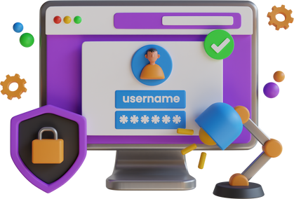


Jan
Project Timeline
Project Initiation: Define goals, requirements, and team roles.
Mar
Design and Development: Create wireframes and develop backend functionalities.
Apr
Database Integration: Set up a robust database system for user profiles.
Jun
User Registration: Implement a seamless registration process for new users.
Jul
Matchmaking Algorithm: Develop an intelligent algorithm for suggesting compatible matches.
Aug
Communication Features: Enable messaging and notifications for user interactions.
Sep
Launch and Testing: Perform testing, fix bugs, and deploy the Matrimony Web Service.
Page: 40

Slide 42
Webpage View
Page: 41

Slide 43
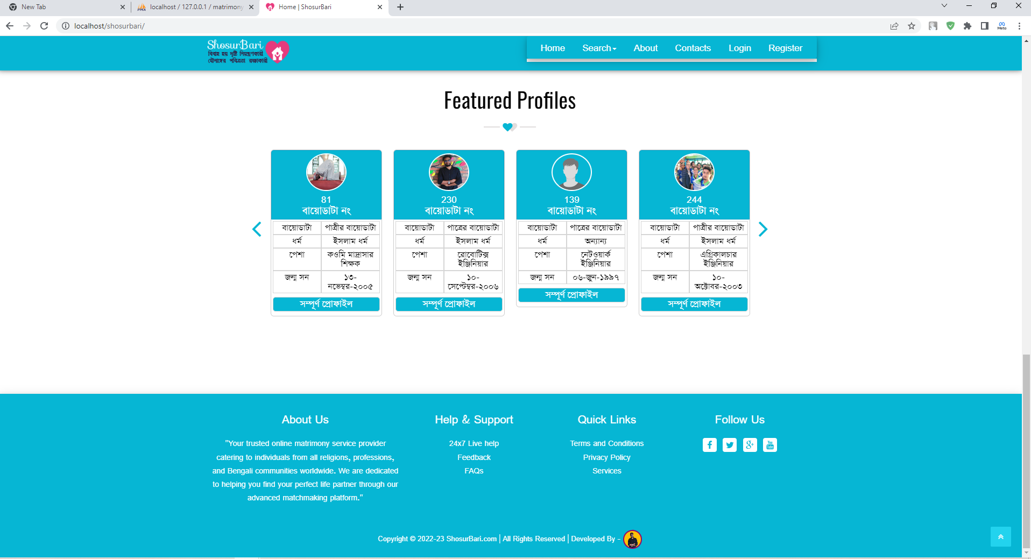
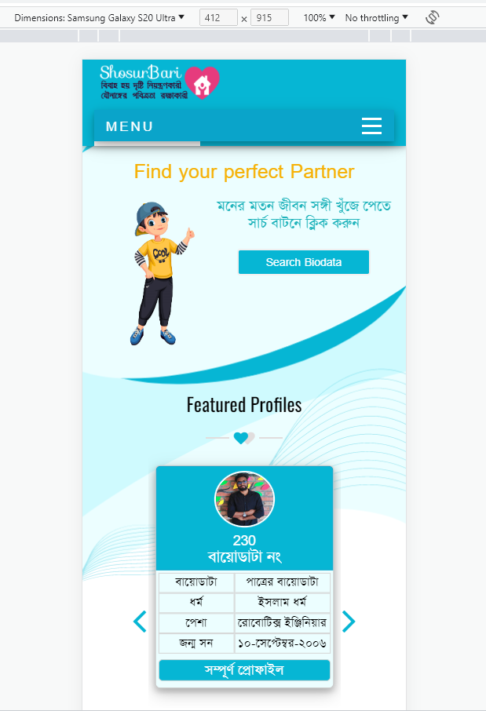
Home Page
Width Screen
Mobile Responsive
Page: 42

Slide 44
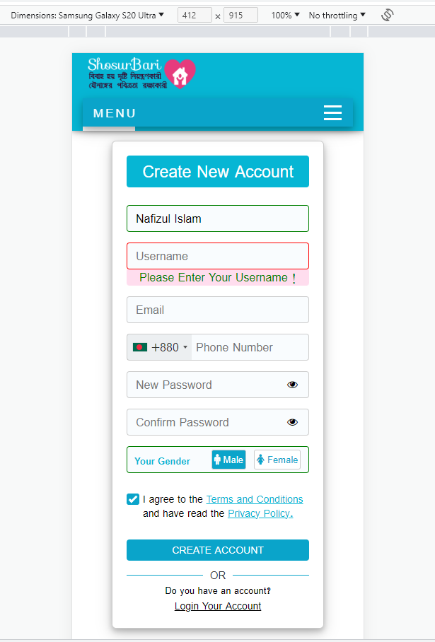
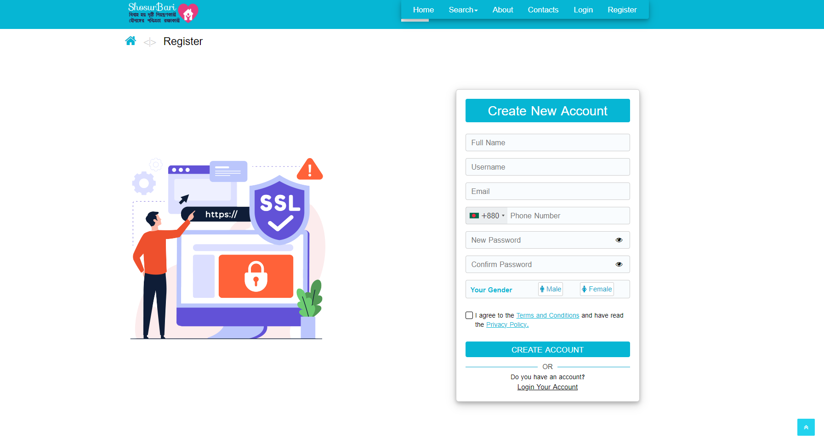
Registration Form
Width Screen
Mobile Responsive
Page: 43

Slide 45
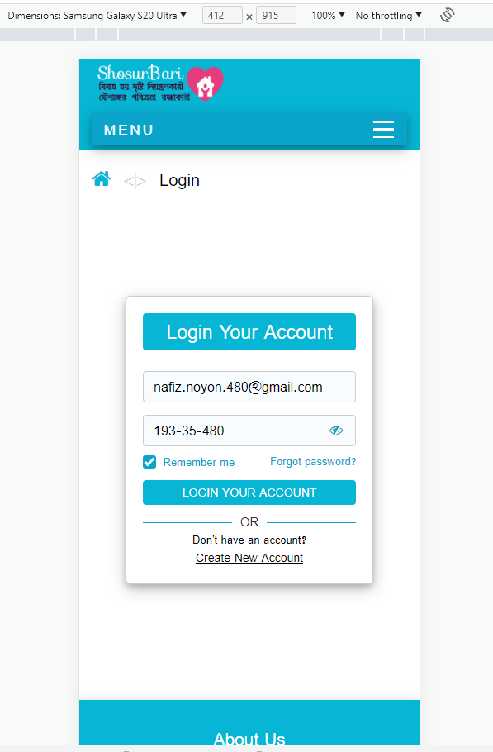
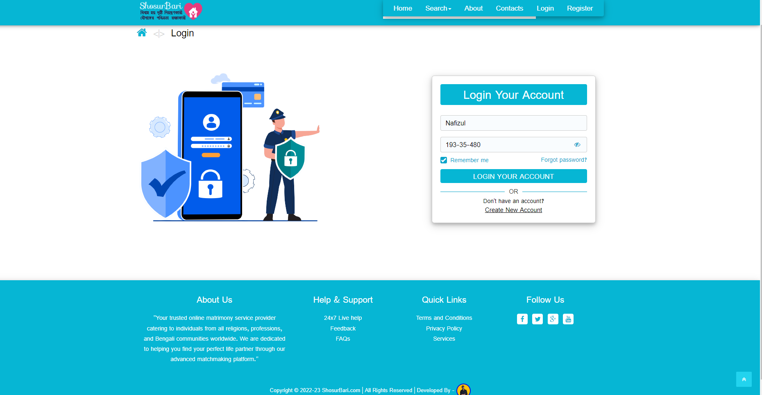
Login Form
Width Screen
Mobile Responsive
Page: 44

Slide 46
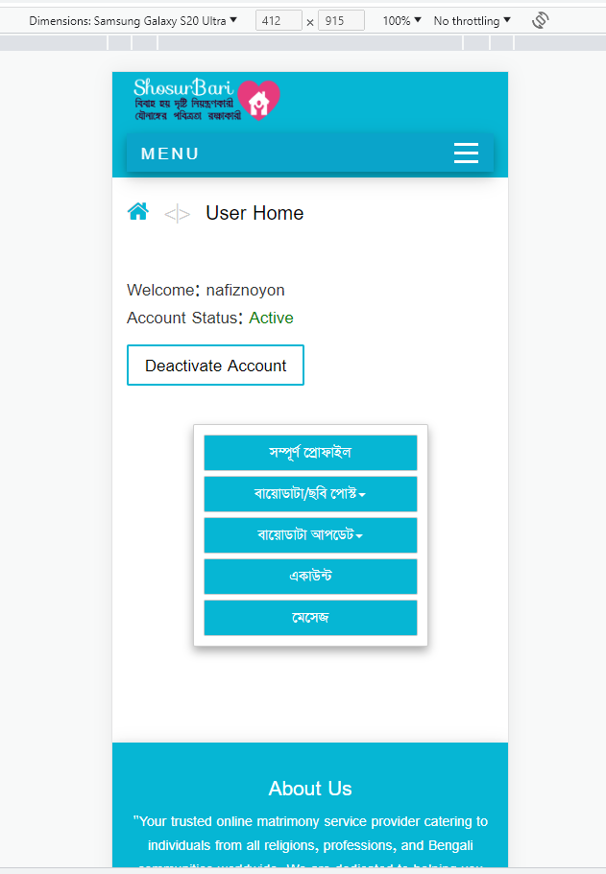
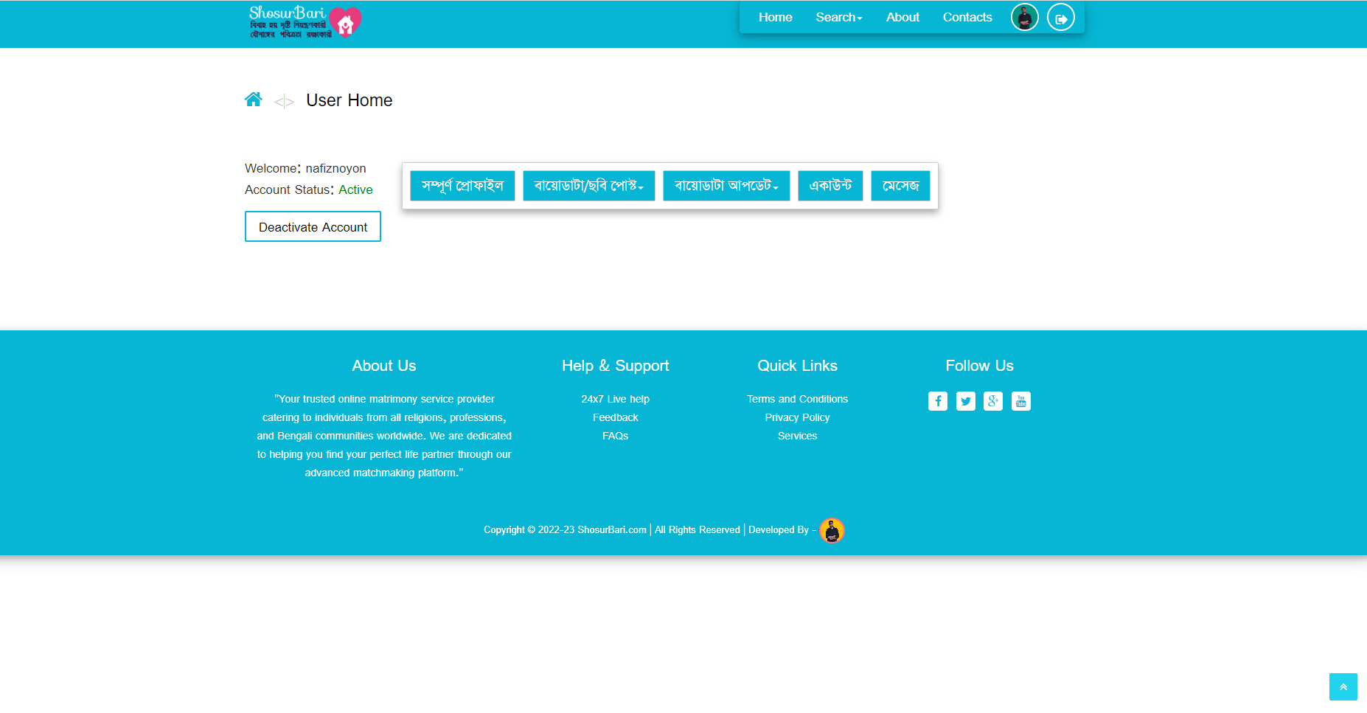
Reg. Member Home Page
Width Screen
Mobile Responsive
Page: 45

Slide 47
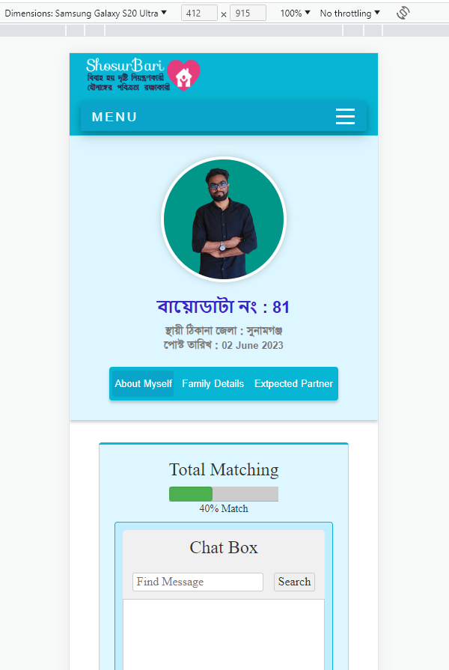
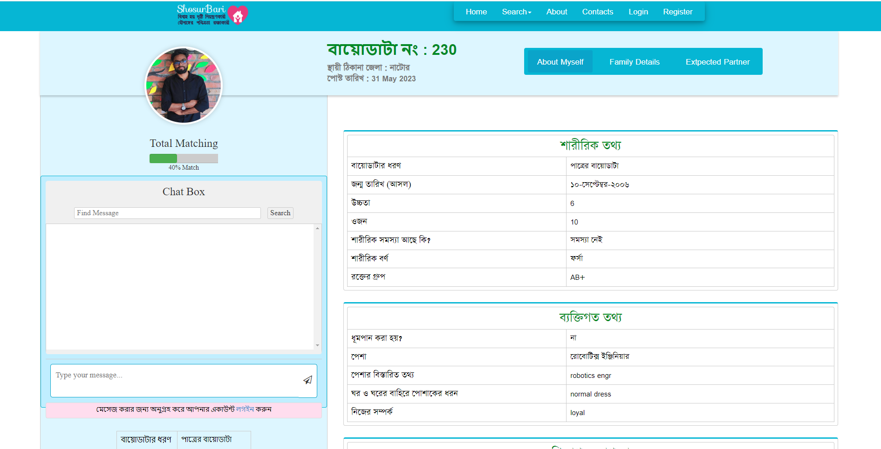
Groom Bride Profile
Width Screen
Mobile Responsive
Page: 46

Slide 48
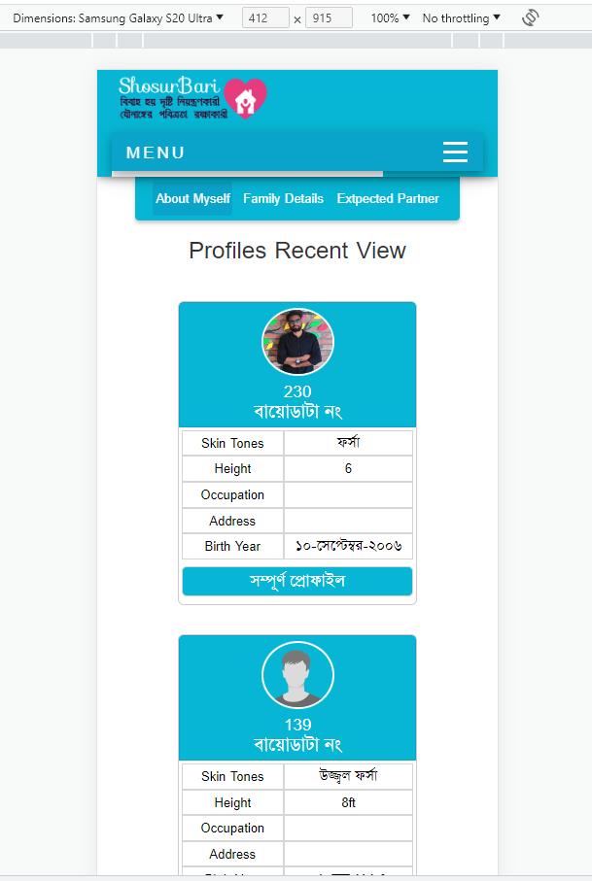
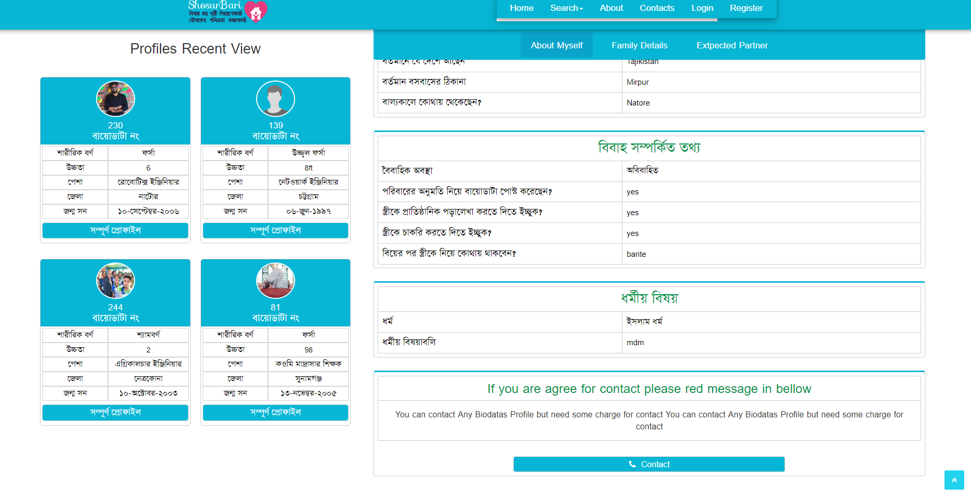
Show Profile Recent View
Width Screen
Mobile Responsive
Page: 47

Slide 49
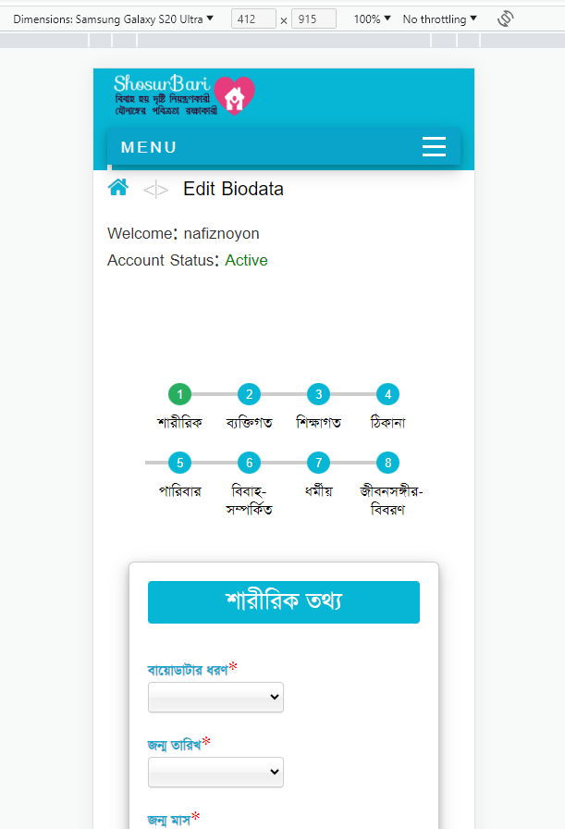
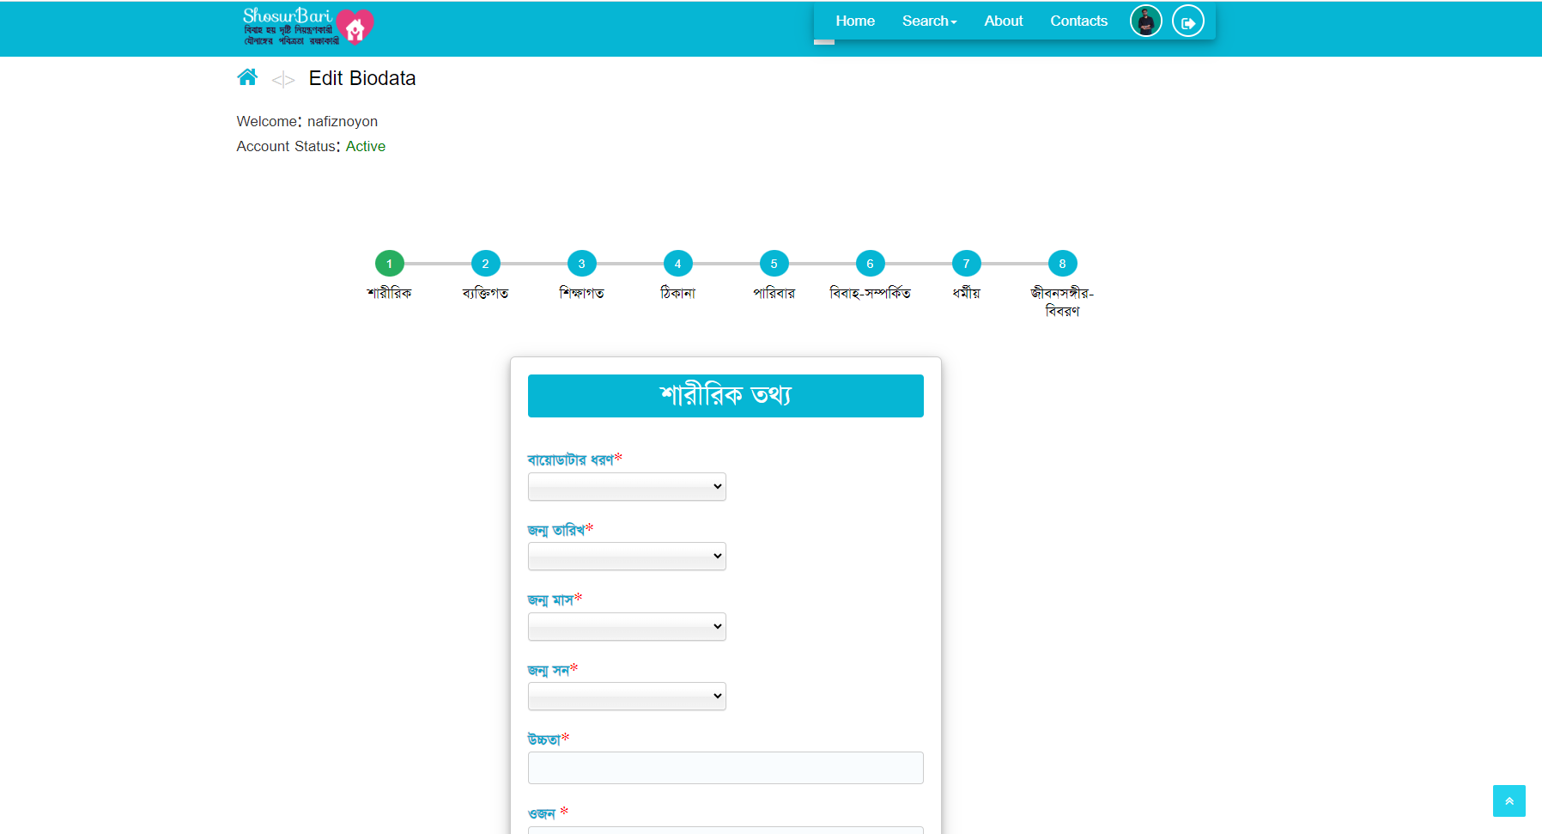
Biodata Post Form Page
Width Screen
Mobile Responsive
Page: 48

Slide 50
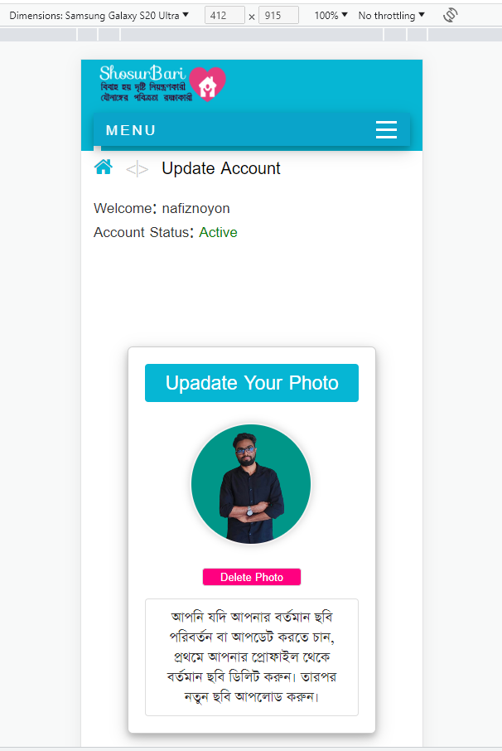
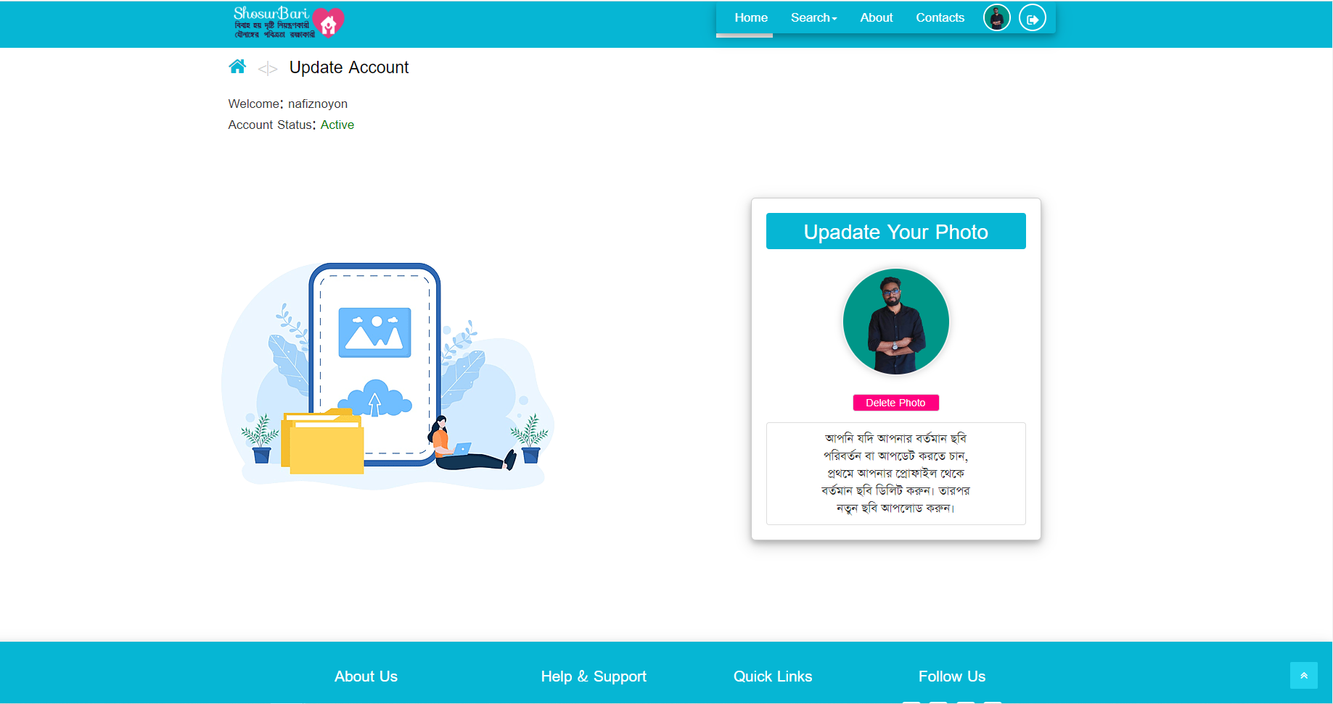
Biodata Post Form Page
Width Screen
Mobile Responsive
Page: 49

Slide 51
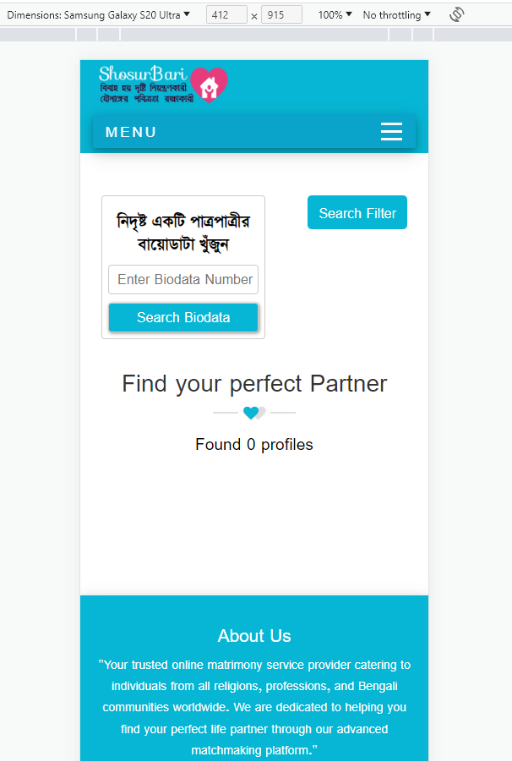
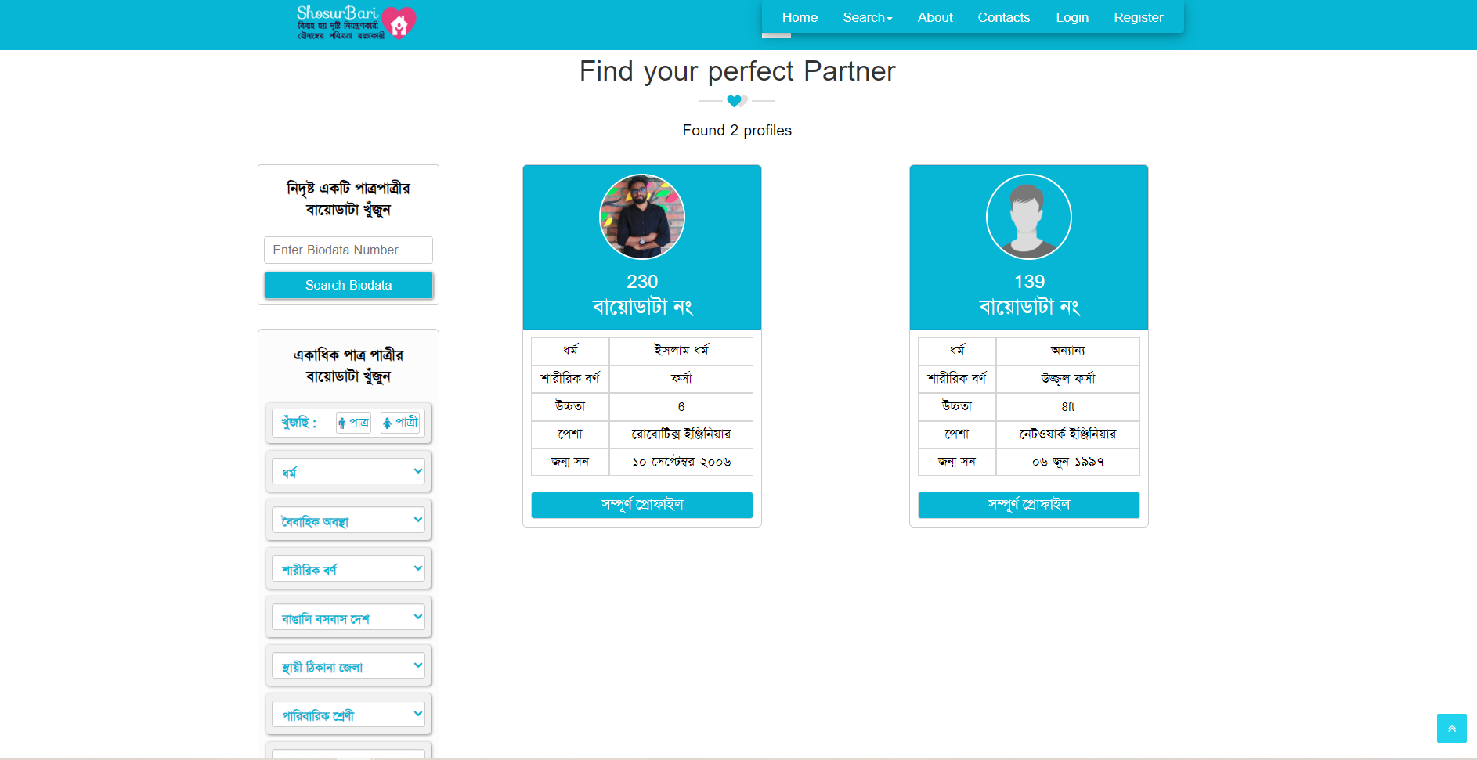
Groom Bride Search
Width Screen
Mobile Responsive
Page: 50

Slide 52
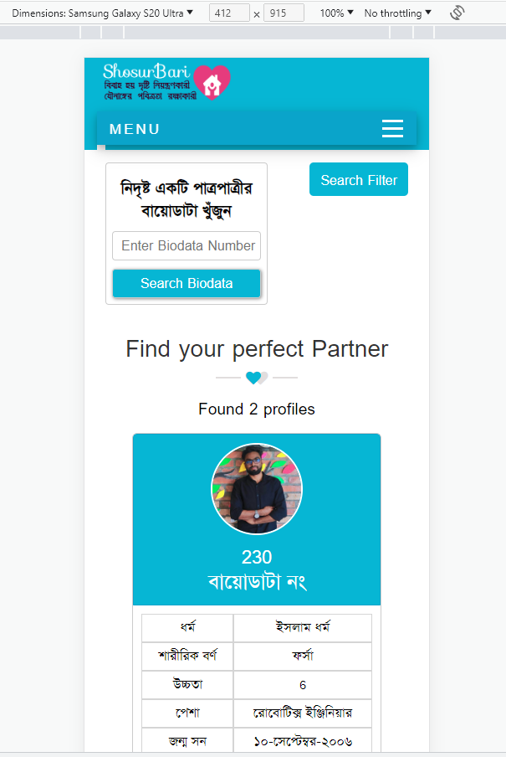
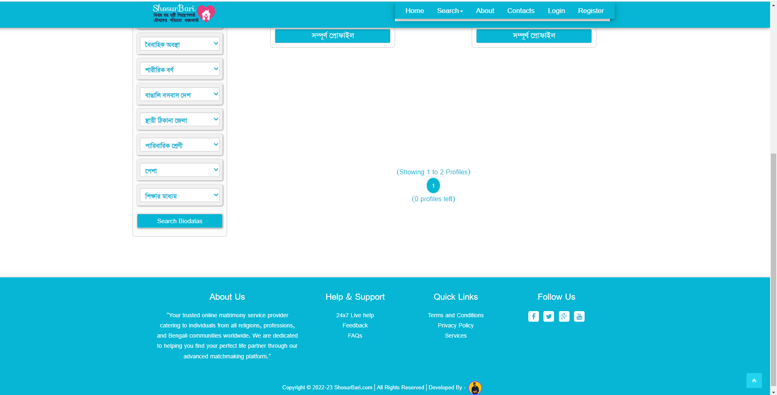
Groom Bride Search
Width Screen
Mobile Responsive
Page: 51

Slide 53
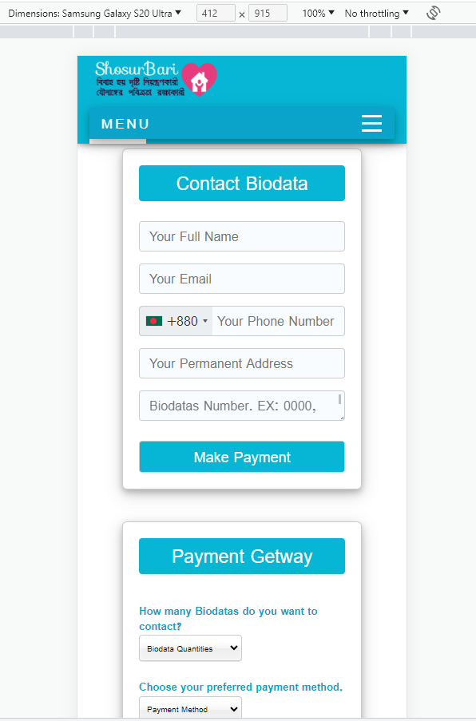
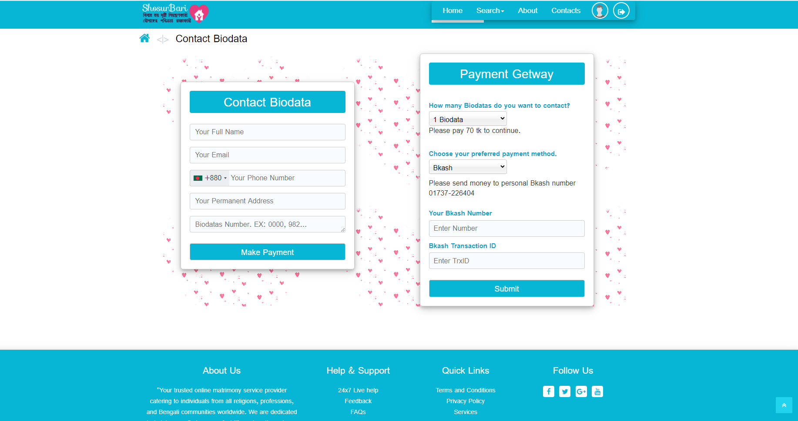
Manual Payment Form
Width Screen
Mobile Responsive
Page: 52

Slide 54
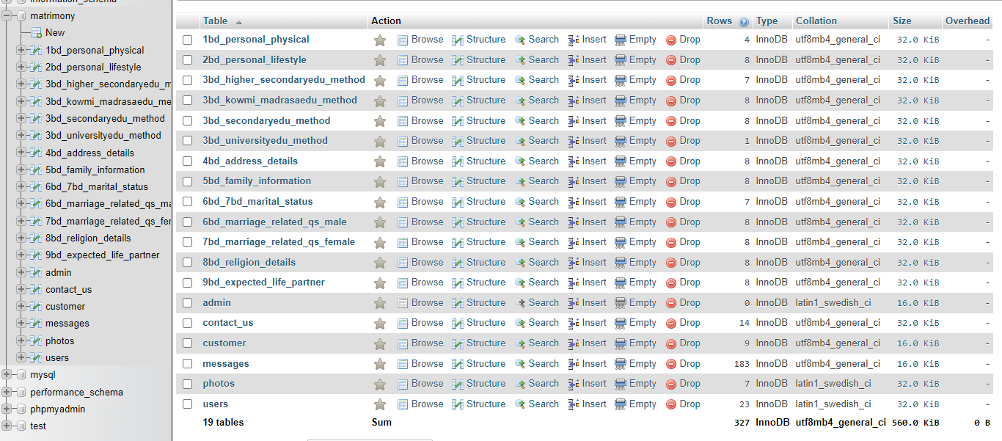
Database
Page: 53

Slide 55
Conclusion
Page: 54

Slide 56
Conclusion
Matrimony Web Service provides a convenient platform for Bangladeshi Bengali communities.
Empowering individuals to find their life partners with ease, flexibility, and reliability.
Page: 55

Slide 57
Reference: I draw all diagrams
https://www.freeprojectz.com/uml-diagram/marrige-buero-management-system-uml-diagram?
https://www.slideshare.net/parthgbhatt/rab-ne-bana-di-jodi-online-matrimonial
https://www.freeprojectz.com/entity-relationship/marrige-buero-management-er-diagram
https://meeraacademy.com/e-r-diagram-for-matrimonial-website
https://www.academia.edu/43102557/SRS_Matrimonial_Website
https://www.lovelycoding.org/online-matrimonial-management-system/
https://creately.com/diagram/example/jrkstpdb2/admin-activity-classic
https://meeraacademy.com/activity-diagram-for-matrimonial-website-project/
Competitor:
https://www.bangladeshimatrimony.com
https://www.taslimamarriagemedia.com
https://www.bdmarriage.com
https://ordhekdeen.com
https://borbodhu.com
Page: 56

Slide 58
THANK YOU
End

